Slide 1
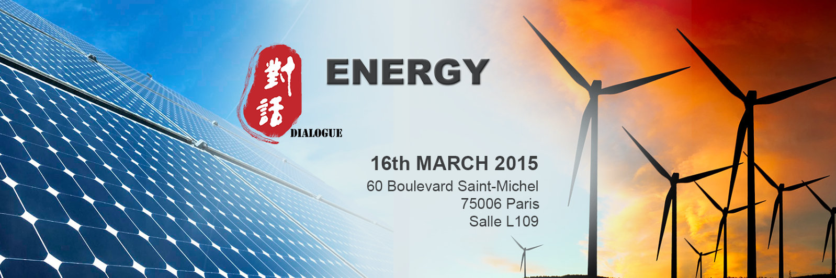



China’s Energy Perspective and Opportunities for French Companies
Organised by
Co-organisation

Slide 2
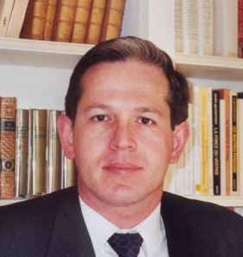





China’s Energy Perspectives and Opportunities for French Companies
Speakers
Grégoire Postel-Vinay
Dominique Richard
Suyan Zhou
Ingénieur Corps des Mines
Head of Strategy dept. of DGE (Direction Général des Entreprises), Ministry for Economy, Industry and Digital affairs
Energy expert
Senior project director, AFD (Agence Française de Développement)
Energy Economist, China Energy Expert
Director of Institutional Relations Asia Pacific, EDF
Experiences & expertise
  Public policies in competitiveness, science and innovation
  Elaboration of a national strategy for research and innovation in Energy, automotive, digital and green technologies
Previously in charge of EU commercial policies issues at the Prime Minister office
Experiences & expertise
  Expert in energy efficiency and renewable energy
  First-hand experiences in hydropower, geothermal, wind power, biomass, energy savings projects in China, Kenya, Uganda, Madagascar, Jordan, Pakistan
Previously worked at BCEOM (Egis group), an engineering company
Experiences & expertise
  Research on energy economy, energy and climate change policies
  In charge of EDF Asia-related activities with global energy institutions (e.g. IEA) and with the Chinese government.
  Ex-EDF Deputy Chief Representative in China
Ex-Representative of Alstom Turbine in China, a key contributor to numerous major Sino-European energy contract (Ertan 二滩, Three Gorges三峡, etc.)

Slide 3
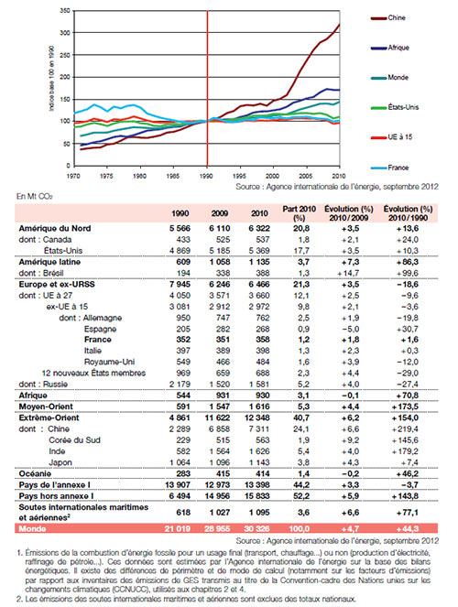
GHG Emissions : 1970-2010 evolutions
Far East already accounts for over 41% of WW emissions and China is over 24% This % will still increase in 2050.
Europe accounts for 12%
France accounts for 1,2% and has the lowest OECD ratio of CO2 per capita&revenue
=> A major role for China + useful cooperation between China & France

Slide 4
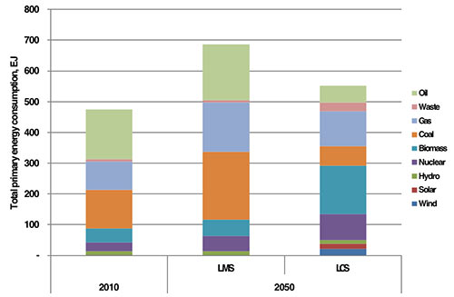
WW GHG Emissions : outlooks for 2050 (source Imperial college UK, 2013)
1 – Business as usual (keeping efforts at the same pace)

Slide 5
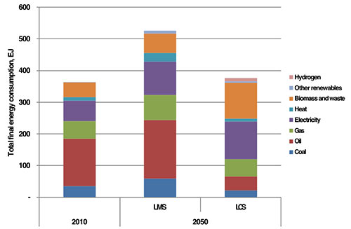
WW GHG Emissions : outlooks for 2050 (source Imperial college UK, 2013)
2 – Low carbon scenario / Proactive policies

Slide 6
Some stylized findings about global warming, the global needs for energy, and its possible solutions
The climate challenge can be overcome at a cost of around 1% per year of global GDP by 2050 in investments;
Presently known technologies enable this (without prejudice to the improvements that might be provided by innovation and R&D);
No solution is possible without a significant increase in the share of electricity in the world energy mix and that this share comes from decarbonised sources;
The low carbon scenario includes both major energy savings and a two-fold rise in world electricity output by 2050, thus reducing annual CO2 production from 32 Bt to 16 Bt in 2050 =>+2° in 2100.
All solutions for electricity will have to be more decarbonized : renewable sources with an overall supply involving the simultaneous production of alternative energies to compensate for the intermittence of some of them (solar, wind) ; capture and storage of the carbon produced by these alternative energies (gas, coal, oil, biomass etc ...) and the retention of nuclear resources. But also the share of the use of electricity in transport has to increase.
On a world scale the share of biomass and the recycling of waste in renewable energies will be preponderant;
Improvements in using less coal and/or using it better, will have positive effects on health and environment.

Slide 7
French assets for cooperation with China :
1- Nuclear Energy
A strong and long term comitment for basic and development nuclear R&D, through the CEA
The widest nuclear electric network
EDF as the biggest nuclear operator in the world
The longest track record for security due to scale effects for PWR reactors
A ww respected agency for security (ASN)
Already a long term cooperation (Daya Bay, Taishan)
A variety of reactors available.
  Areva’s ATMEA1 with already an agreement with Turkey for 4 reactors,
  CPR-1000, China Guangdong Nuclear Power Company (15 reactors, in partnership with EDF, Ling-Ao3 connected in July 20)10
  Experiences with other reactors
Ongoing long term planning both at national and EU level including nuclear capacities, whereas in China nuclear energy in the energy mix should raise from 1% in 2013 to 6% in 2035 .
China’s nuclear program is by far the biggest in the world and France will carry on depending on nuclear energy for electricity => common long term interests.
For the very long term : China is a member of the International Thermonuclear Experimental Reactor (ITER program), and the reactor is located in France (Cadarache)

Slide 8
French assets for cooperation with China :
2- Hydropower
The French hydropower industry : 10.500 employees and about €B 3,2 turnover.
Large installed capacities (EDF, GDF-SUEZ managing them, mostly + smaller firms)
Alstom power hydro : 1st worldwide
France Bouvier hydro, Mecamidi for smaller turbines
Engineering : Tractebel (GDF-SUEZ), SOGREAH…
New technologies for low waterfalls : MJ2 Techn.
A knowledge to coordinate decarbonated sources :

Slide 9
French assets for cooperation with China :
3 – High efficiency coal power plants
The biggest issue for China, using ~1350 tec of coal in 2013, 69% of its primary enery mix, and up to 1610 tec (2300tep) in 2035 : +20%, despite a big effort to reduce the share of coal from 69 to 51%.
interest for supercritical generators.
  A cooperation in supercritical generators has been lauchned in 2007 with EDF and China Datang Corp, in Henan, (Sanmenxia)
  Alstom masters supercritical and ultra supercritical technologies
  A field in which the competition is particularly intense
Interest for Carbon capture and storage (Total Alstom Air Liquide, Geostock... + research centers : IFP BRGM..)

Slide 10
French assets for cooperation with China :
4-Renewables
4- 1 Wind energy :
In 2014, France had 8,3 GW coming from wind energy, about 1 200 windmills, from the biggests to small ones.
Every year about 500 new windmills installed in France. The global annual production should raise from 11TWh in 2011 to over 25TWh in 2020. (the fastest growing energy recently in F).
- Wind takes 15,6% of renewable energies in France, second after hydropower. The ww figure is 11,4%.
About 70 producers in France. Alstom has installed or is installing about 3 500 windmills worldwide, in more than 300 wind farms, for about 6,5GW ; this includes extreme conditions for the plants (deserts, very cold or very hot or very windy places). Offshore turbines (for instance Haliade Turbine 6MW with a rotor of 150m of diameter and a 15% better yield than other models)
4-2 Biomass
Operators such as Dalkia, GDF Suez, IFPEN, CEA, Leroux & Lotz.. About 30 firms and ten research centers. Plus the bioethanol issue.
4-3 : Hydrogen : with Air Liquide and various other firms.
4-4 : Solar energy : (EDF, Total, and also links with the building industries, such as St Gobain)

Slide 11
French assets for cooperation with China :
5- Higher energy efficiency solutions
5-1 Smart cities : a large part of energy is and will me consumed in vast metroples. Thus the Chinese government has started a large program to develop ~200 smart cities. Cooperation between China and France has started on 3 among them. Some instances like
- High level cooperation agreements signed with the Chinese government in 2014 with Vivapolis (Shenyang…)
visits of members from Universities of Beihang, Beijing, Wuhan and Dalian, as well as members of Digital China, the Taiji Computer Company, in the smart city of Issy les Moulineaux in 2014..
Bilateral exchanges with Schneider, Alstom, EDF, Veolia, Dalkia, GDF Suez, St Gobain, Lafarge, Bureau Veritas and IT firms etc concerning
  Smart transportation (tram, buses, metro, car sharing, electric or hybrid cars, road monitoring..)
  Energy savings in homes and offices
  Standards and certification for high quality buildings concerning energy consumption.
5-2 Higher transmission & network efficiency
This again concerns Alstom and Schneider Electric among others.
5-3 Energy storage
Electricity : 99% of the WW market (127GW, 35 in EU) depends on pumping water, for which France has a large experience. Numerous research programs are involved on other solutions.
Others : mostly linked to other industries and services technologies.

Slide 12
Thank you for your attention.

Slide 13
GHG Emissions : Figures 1990-2010

